Slide 1
MTK DLP Lab1 - Backpropagation
TA 鍾嘉峻
Aug 19, 2020

Slide 2
Outline
Lab Objective
Important Date
Lab Description
Scoring Criteria
Notes:
This course is a graduate-level course, which was first offered in spring term of 2017.
It is instructed by two other professors and me.
Back then, about 55 students were enrolled in this course.
In fact, we had a lot more students hoping to take it.
But, we could accept only 60 of them due to limited GPUs we have.
This course was concluded with a workshop in July this summer, with 26 teams presenting their final projects.
In this workshop, we also invited few experts from the industry to grade the students’ performance.
Some of them were amazed by the diversity of the students’ projects.

Slide 3
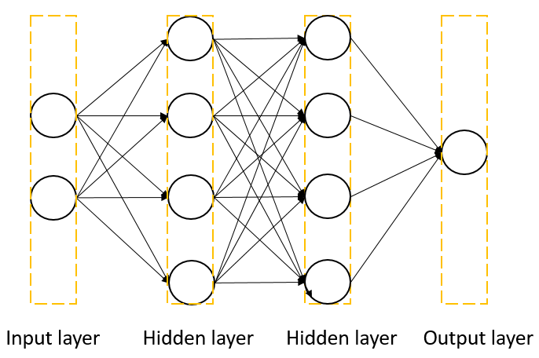
Lab Objective
In this lab, you will need to understand and implement a simple neural network with forward and backward pass using two hidden layers

Slide 4
Important Date
Report Submission Deadline: 9/2 (Wed) 11:59 a.m
Demo date: 9/2 (Wed)
Zip all files in one file
Report (.pdf)
Source code
name it like「DLP_LAB1_yourID_name.zip」
ex: 「DLP_LAB1_0756172_鍾嘉峻.zip」
Email to
Zivzhong.cs07g@nctu.edu.tw

Slide 5
Lab Description
Implement a simple neural network with two hidden layers
You can only use Numpy and other python standard libraries.
Plot your comparison figure showing the predictions and ground truth.
Plot your learning curve (loss, epoch).
Print the accuracy of your prediction.

Slide 6
Lab Description – Flowchart
Prepare data
Create model
Forward pass
Repeat n times or until convergence
Training
Backward pass
Update weights

Slide 7
Lab Implementation Steps
Data prepare
Create a model
Train
Test
Plot result

Slide 8
Lab Implementation Steps
Data prepare
Create a model
Train
Test
We don’t need to do this this time
Plot result

Slide 9
Lab Implementation Steps
Data prepare
Create a model
Train
Test
We don’t need to do this this time
Plot result
Just show the loss of training set we create!!

Slide 10
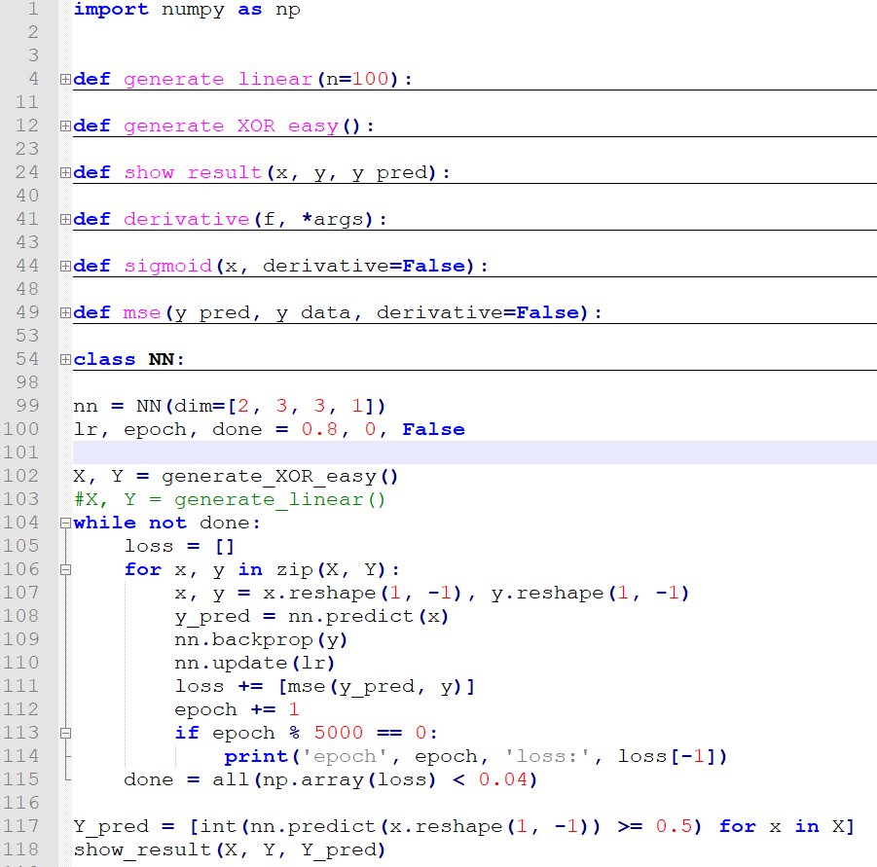
Lab Implementation Steps
Data prepare
Create a model
Train
Plot result

Slide 11
Lab Implementation Steps
Data prepare
Use the functions TA prepare
Create a model
Train
Plot result

Slide 12
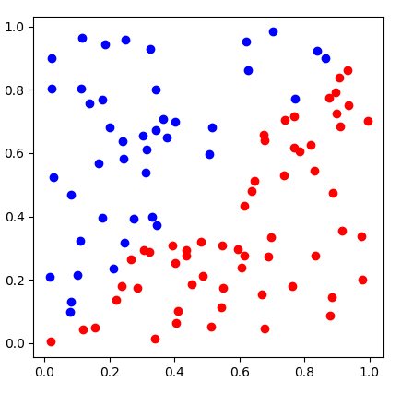
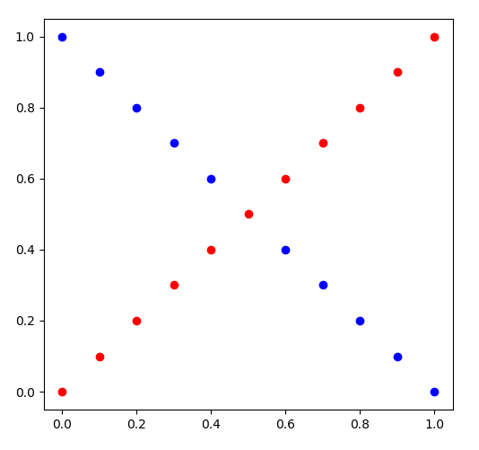
Lab Description - Data
generate_linear()
generate_XOR_easy()

Slide 13
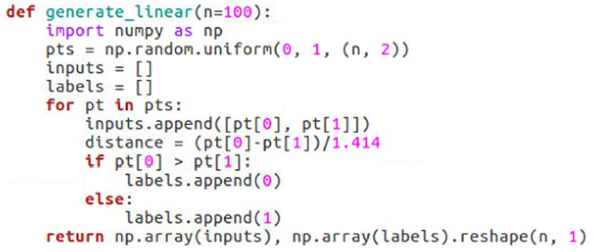
Lab Description - Data
generate_linear()

Slide 14
Lab Description - Data
generate_linear()
generate_XOR_easy()

Slide 15
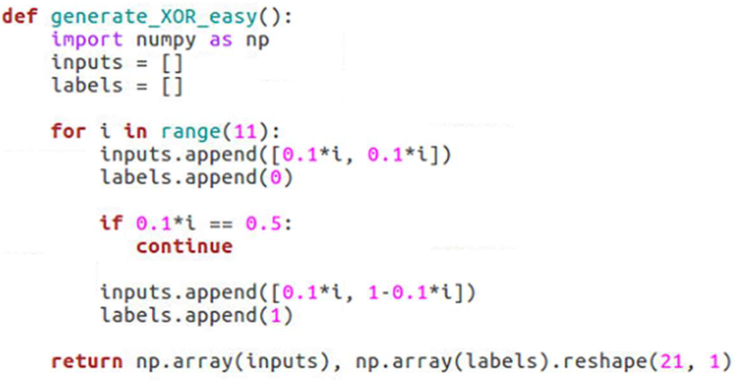
Lab Description - Data
generate_XOR_easy()

Slide 16
Lab Implementation Steps
Data prepare
Create a model
You can only use numpy or other standard python library
Train
Plot result

Slide 17
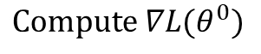
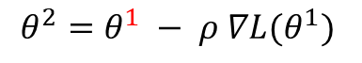
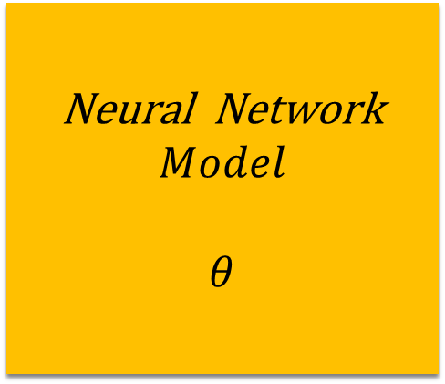
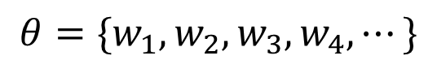
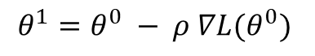

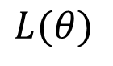
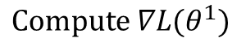

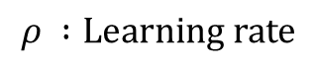
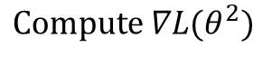

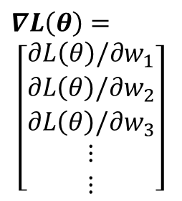
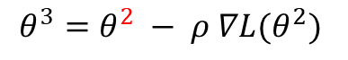
Lab Description
$${ x}^{n}$$
Neural Network
$$Model$$
$$θ$$
$${ y}^{n}$$
$${ \hat{y}}^{n}$$
Loss Function
$$L(θ)$$
Input
Model
Output
Ground
truth
$$∇L\left(θ\right)=$$
$$\left[\begin{aligned}∂L\left(θ\right)/∂w_{1} \\ ∂L\left(θ\right)/∂w_{2} \\ ∂L\left(θ\right)/∂w_{3} \\ ⋮ \\ ⋮\end{aligned}\right]$$
$${Compute ∇L(θ}^{0})$$
$$θ^{1}={θ^{0} − ρ ∇L(θ}^{0})$$
$$θ=\{w_{1},w_{2},w_{3},w_{4},⋯\}$$
$${Compute ∇L(θ}^{1})$$
$$θ^{2}={θ^{1} − ρ ∇L(θ}^{1})$$
$${Compute ∇L(θ}^{2})$$
$$θ^{3}={θ^{2} − ρ ∇L(θ}^{2})$$
$$ρ :Learning rate$$

Slide 18
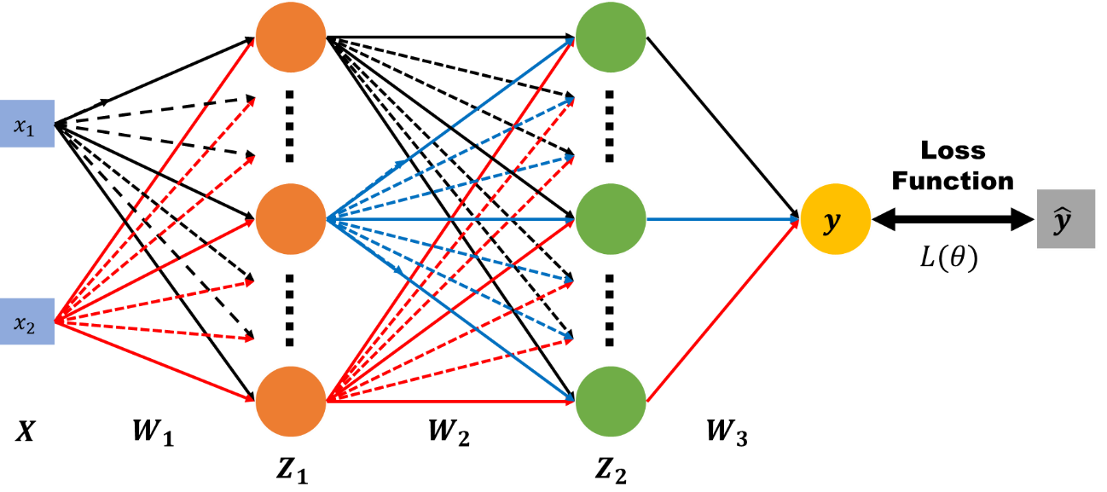
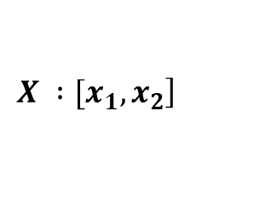
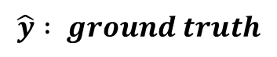
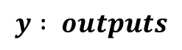
Lab Description – Architecture
$$\left.X :[x_{1}, x_{2}\right]$$
$$y : outputs$$
$$\hat{y} : ground truth$$
$W_{1}, W_{2}, W_{3}$ $: weight matrix of network layers$

Slide 19
Lab Description – Architecture
Define 4 layers
One input layer
Two hidden layers
One output layer
Define 3 groups of weights
Between any two adjacent layers

Slide 20
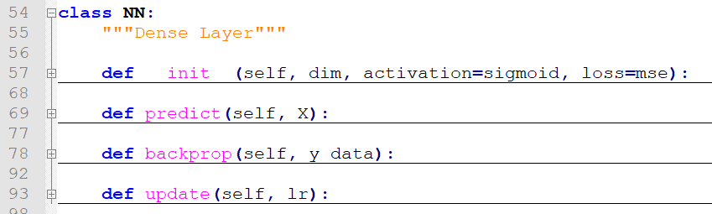
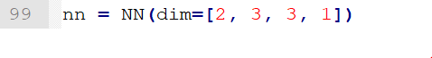
Lab Description – Create a Model

Slide 21
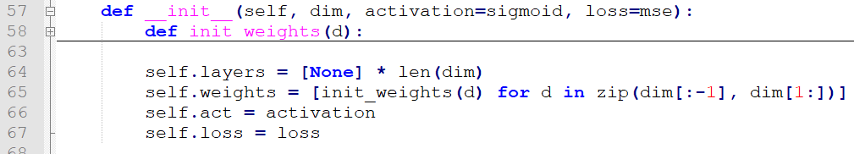
Lab Description – Create a Model

Slide 22
Lab Implementation Steps
Data prepare
Create a model
Train
Loss
Forward
Backward
Plot result

Slide 23

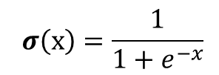
Lab Description – Forward
$Z_{1}=σ(XW_{1})$ $Z_{2}=σ(Z_{1}W_{2})$ $y=σ(Z_{2}W_{3})$
$$σ\left(x\right)=\frac{1}{1+e^{−x}}$$

Slide 24
Lab Description – Training Part

Slide 25
Lab Description – Loss
MSE Loss

Slide 26
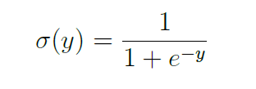
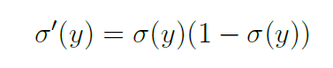
Lab Description – Forward(Predict)
Forward(Predict)
Z = X
for i, W in enumerate(self.weights):
Z = self.act(Z @ W)
Remember move to next layer
(e.g self.layers[next_layer] = np.array(Z)
Ref Link:
https://medium.com/pyradise/%E4%BD%BF%E7%94%A8-python-%E4%BE%86%E8%AA%8D%E8%AD%98%E7%9F%A9%E9%99%A3-915376207187

Slide 27
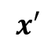
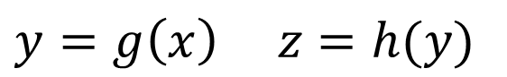
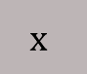
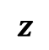
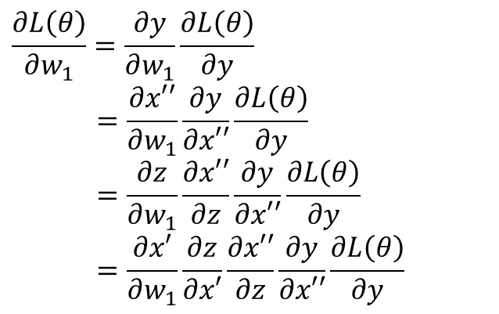
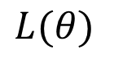
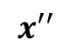
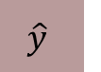
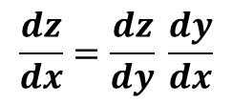
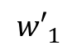
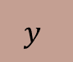
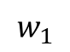
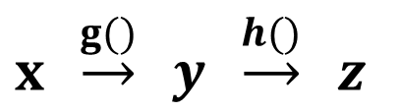
Lab Description – Backward
$$x′$$
$$z$$
$$x′′$$
$$x$$
$$y$$
$$\hat{y}$$
$$w_{1}$$
$${w′}_{1}$$
$$L(θ)$$
$x′=xw_{1}$ $z=σ(x′)$ $x′′=z{w′}_{1}$ $y=σ(x′′)$
$$\frac{∂L\left(θ\right)}{∂w_{1}}=\frac{∂y}{∂w_{1}}\frac{∂L\left(θ\right)}{∂y}$$
$$=\frac{∂x′′}{∂w_{1}}\frac{∂y}{∂x′′}\frac{∂L\left(θ\right)}{∂y}$$
$$=\frac{∂z}{∂w_{1}}\frac{∂x′′}{∂z}\frac{∂y}{∂x′′}\frac{∂L\left(θ\right)}{∂y}$$
$$=\frac{∂x′}{∂w_{1}}\frac{∂z}{∂x′}\frac{∂x′′}{∂z}\frac{∂y}{∂x′′}\frac{∂L\left(θ\right)}{∂y}$$
Chain rule
$y=g\left(x\right) z=h(y)$
$x \underset{→}{g()} y \underset{→}{h()} z$
$$\frac{dz}{dx}=\frac{dz}{dy} \frac{dy}{dx}$$

Slide 28
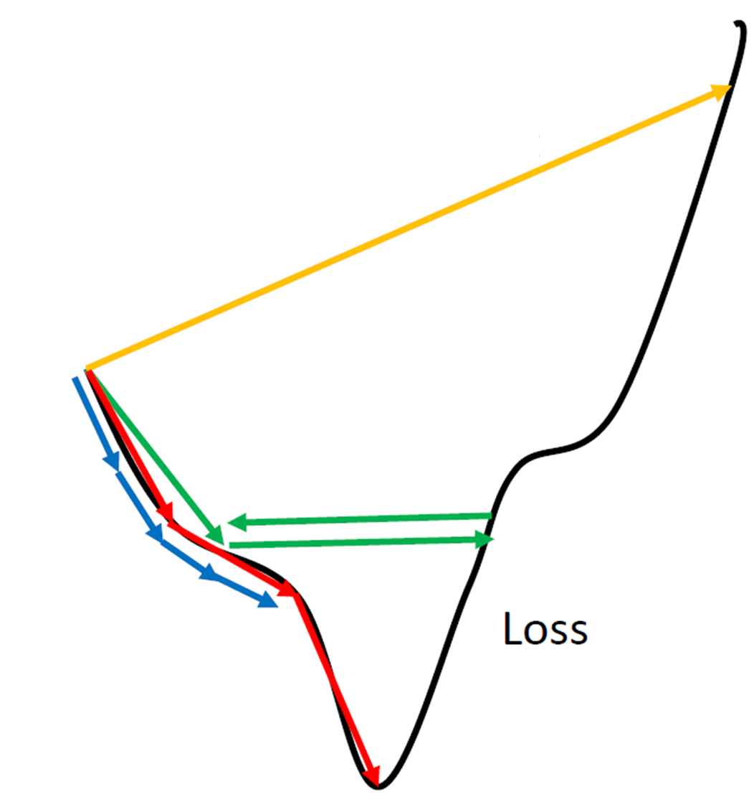


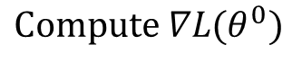
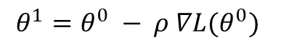
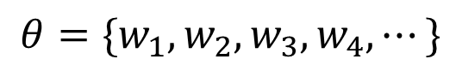
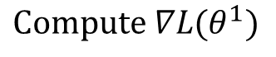
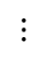
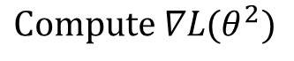
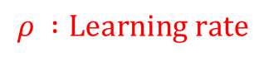
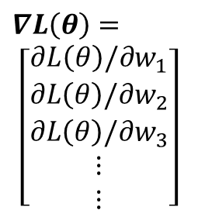

Lab Description – Gradient descent
Network Parameters
$$θ=\{w_{1},w_{2},w_{3},w_{4},⋯\}$$
$$∇L\left(θ\right)=$$
$$\left[\begin{aligned}∂L\left(θ\right)/∂w_{1} \\ ∂L\left(θ\right)/∂w_{2} \\ ∂L\left(θ\right)/∂w_{3} \\ ⋮ \\ ⋮\end{aligned}\right]$$
$${Compute ∇L(θ}^{0})$$
$$θ^{1}={θ^{0} − ρ ∇L(θ}^{0})$$
$$ρ :Learning rate$$
$${Compute ∇L(θ}^{1})$$
$$θ^{2}={θ^{1} − ρ ∇L(θ}^{1})$$
$${Compute ∇L(θ}^{2})$$
$$θ^{3}={θ^{2} − ρ ∇L(θ}^{2})$$
$$⋮$$
http://www.denizyuret.com/2015/03/alec-radfords-animations-for.html

Slide 29
Lab Description – Backward & Update
Backward the gradient & update

Slide 30
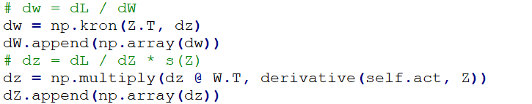
Lab Description – Backward & Update
Backward the gradient & update
Gradient
Update

Slide 31
Lab Implementation Steps
Data prepare
Create a model
Train
Plot result
Screenshot of loss
Plot the prediction & ground truth

Slide 32


Lab Description - Prediction
In the training, you need to print loss
In the testing, you need to show your predictions, also the accuracy

Slide 33

Lab Description - Prediction
Visualize the predictions and ground truth at the end of the training process

Slide 34

Lab Description - Prediction
Visualize the predictions and ground truth at the end of the training process

Slide 35

Demo
Video Link: https://youtu.be/OdwA9SaMh4E

Slide 36
Demo
Video Link: https://youtu.be/OdwA9SaMh4E

Slide 37
Scoring Criteria
Report (40%)
Demo(60%)
Experimental results (40%)
Questions (20%)
Late report or demo
Score *0.8

Slide 38
Reference
http://www.denizyuret.com/2015/03/alec-radfords-animations-for.html
http://speech.ee.ntu.edu.tw/~tlkagk/courses_ML17_2.html

Slide 39
Backup Slide
In python, you may observe some weird things
0.1+0.2 != 0.3 (because IEEE 754
0.2+0.1 != 0.3
0.1+0.2 == 0.2+0.1

Slide 40
Backup Slide
In python, you may observe some weird things
0.1+0.2 != 0.3 (because IEEE 754
0.2+0.1 != 0.3
0.1+0.2 == 0.2+0.1
0.1+0.2+0.1+0.2 != 0.6
0.2+0.1+0.2+0.1 == 0.6
0.1+0.2+0.1+0.2 != 0.2+0.1+0.2+0.1

Slide 41

Backup Slide
In python, you may observe some weird things
0.1+0.2 != 0.3 (because IEEE 754
0.2+0.1 != 0.3
0.1+0.2 == 0.2+0.1
0.1+0.2+0.1+0.2 != 0.6
0.2+0.1+0.2+0.1 == 0.6
0.1+0.2+0.1+0.2 != 0.2+0.1+0.2+0.1

Slide 42
Backup Slide
In python, you may observe some weird things
0.1+0.2 != 0.3 (because IEEE 754
0.2+0.1 != 0.3
0.1+0.2 == 0.2+0.1
0.1+0.2+0.1+0.2 != 0.6
0.2+0.1+0.2+0.1 == 0.6
0.1+0.2+0.1+0.2 != 0.2+0.1+0.2+0.1
Check WTFPython
https://github.com/satwikkansal/wtfpython

